Slide 1
GUIDELINES

Slide 2
SLIDE DIMENSIONS
1920x1080 px

Slide 3
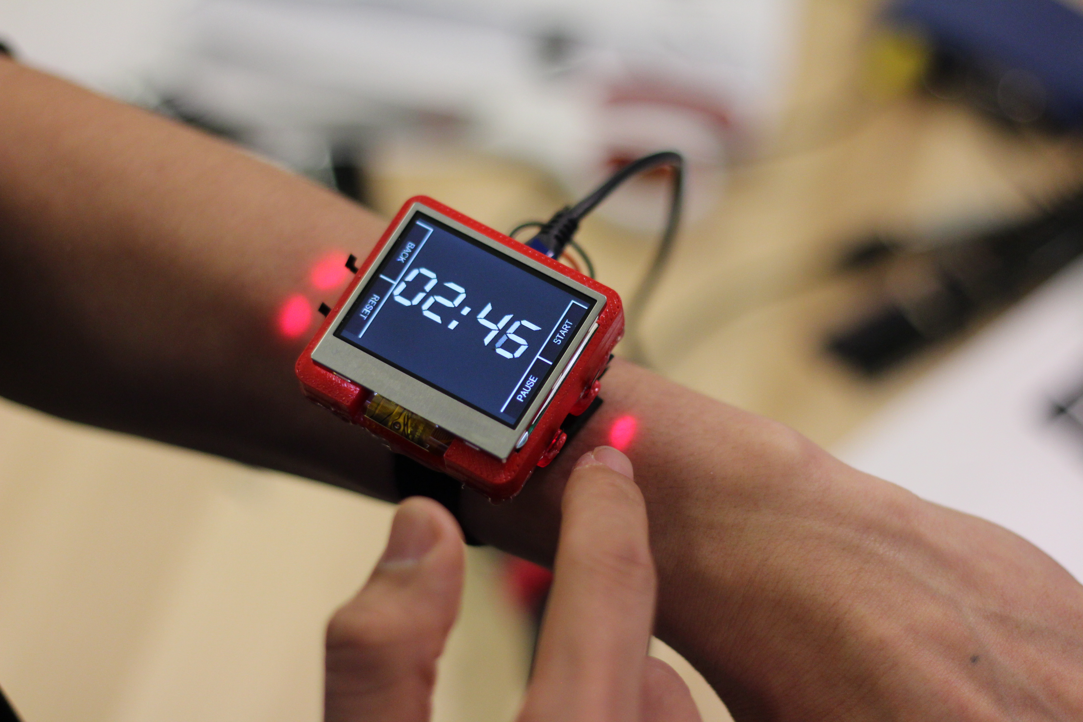
LEAVE ENOUGH MARGIN
Skin Buttons
Gierad Laput Robert Xiao Xiang Chen Scott Hudson Chris Harrison
Smartwatches are a promising new interactive platform, but their small size makes even basic actions cumbersome. Hence, there is a great need for approaches that expand the interactive envelope around smartwatches, allowing human input to escape the small physical confines of the device. We propose using tiny projectors integrated into the smartwatch to render icons on the user's skin. These icons can be made touch sensitive, significantly expanding the interactive region without increasing device size. Through a series of experiments, we show that these 'skin buttons' can have high touch accuracy and recognizability, while being low cost and power-efficient.

Slide 4
KEEP ABSTRACT SHORT:
~100 Words
BG Color: #000000, 85% Opacity
Skin Buttons
Gierad Laput Robert Xiao Xiang Chen Scott Hudson Chris Harrison
Smartwatches are a promising new interactive platform, but their small size makes even basic actions cumbersome. Hence, there is a great need for approaches that expand the interactive envelope around smartwatches, allowing human input to escape the small physical confines of the device. We propose using tiny projectors integrated into the smartwatch to render icons on the user's skin. These icons can be made touch sensitive, significantly expanding the interactive region without increasing device size. Through a series of experiments, we show that these 'skin buttons' can have high touch accuracy and recognizability, while being low cost and power-efficient.

Slide 5
BG Color: #000000, 85% Opacity
Alt Text Layout
Skin Buttons: Cheap, Low-Powered, and Clickable Fixed Image Laser Projectors
Gierad Laput Robert Xiao Xiang Chen Scott Hudson Chris Harrison
Smartwatches are a promising new interactive platform, but their small size makes even basic actions cumbersome. Hence, there is a great need for approaches that expand the interactive envelope around smartwatches, allowing human input to escape the small physical confines of the device. We propose using tiny projectors integrated into the smartwatch to render icons on the user's skin. These icons can be made touch sensitive, significantly expanding the interactive region without increasing device size. Through a series of experiments, we show that these 'skin buttons' can have high touch accuracy and recognizability, while being low cost and power-efficient.

Slide 6
Fonts: Gill Sans or Helvetica
BG Color: #720C04, 85% Opacity
Skin Buttons
Gierad Laput Robert Xiao Xiang Chen Scott Hudson Chris Harrison
Smartwatches are a promising new interactive platform, but their small size makes even basic actions cumbersome. Hence, there is a great need for approaches that expand the interactive envelope around smartwatches, allowing human input to escape the small physical confines of the device. We propose using tiny projectors integrated into the smartwatch to render icons on the user's skin. These icons can be made touch sensitive, significantly expanding the interactive region without increasing device size. Through a series of experiments, we show that these 'skin buttons' can have high touch accuracy and recognizability, while being low cost and power-efficient.

Slide 7
BG Color: #1D163D, 85% Opacity
Skin Buttons
Gierad Laput Robert Xiao Xiang Chen Scott Hudson Chris Harrison
Smartwatches are a promising new interactive platform, but their small size makes even basic actions cumbersome. Hence, there is a great need for approaches that expand the interactive envelope around smartwatches, allowing human input to escape the small physical confines of the device. We propose using tiny projectors integrated into the smartwatch to render icons on the user's skin. These icons can be made touch sensitive, significantly expanding the interactive region without increasing device size. Through a series of experiments, we show that these 'skin buttons' can have high touch accuracy and recognizability, while being low cost and power-efficient.

Slide 8
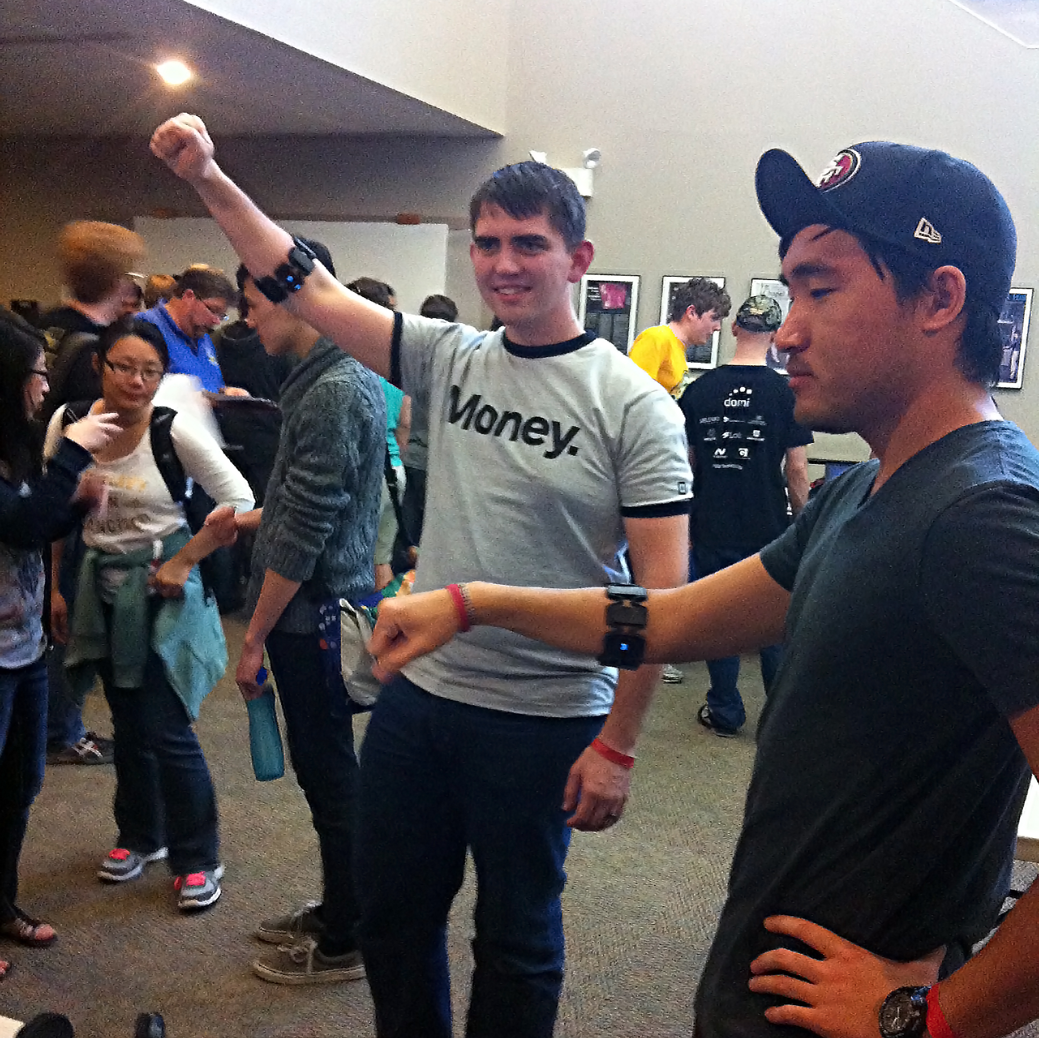
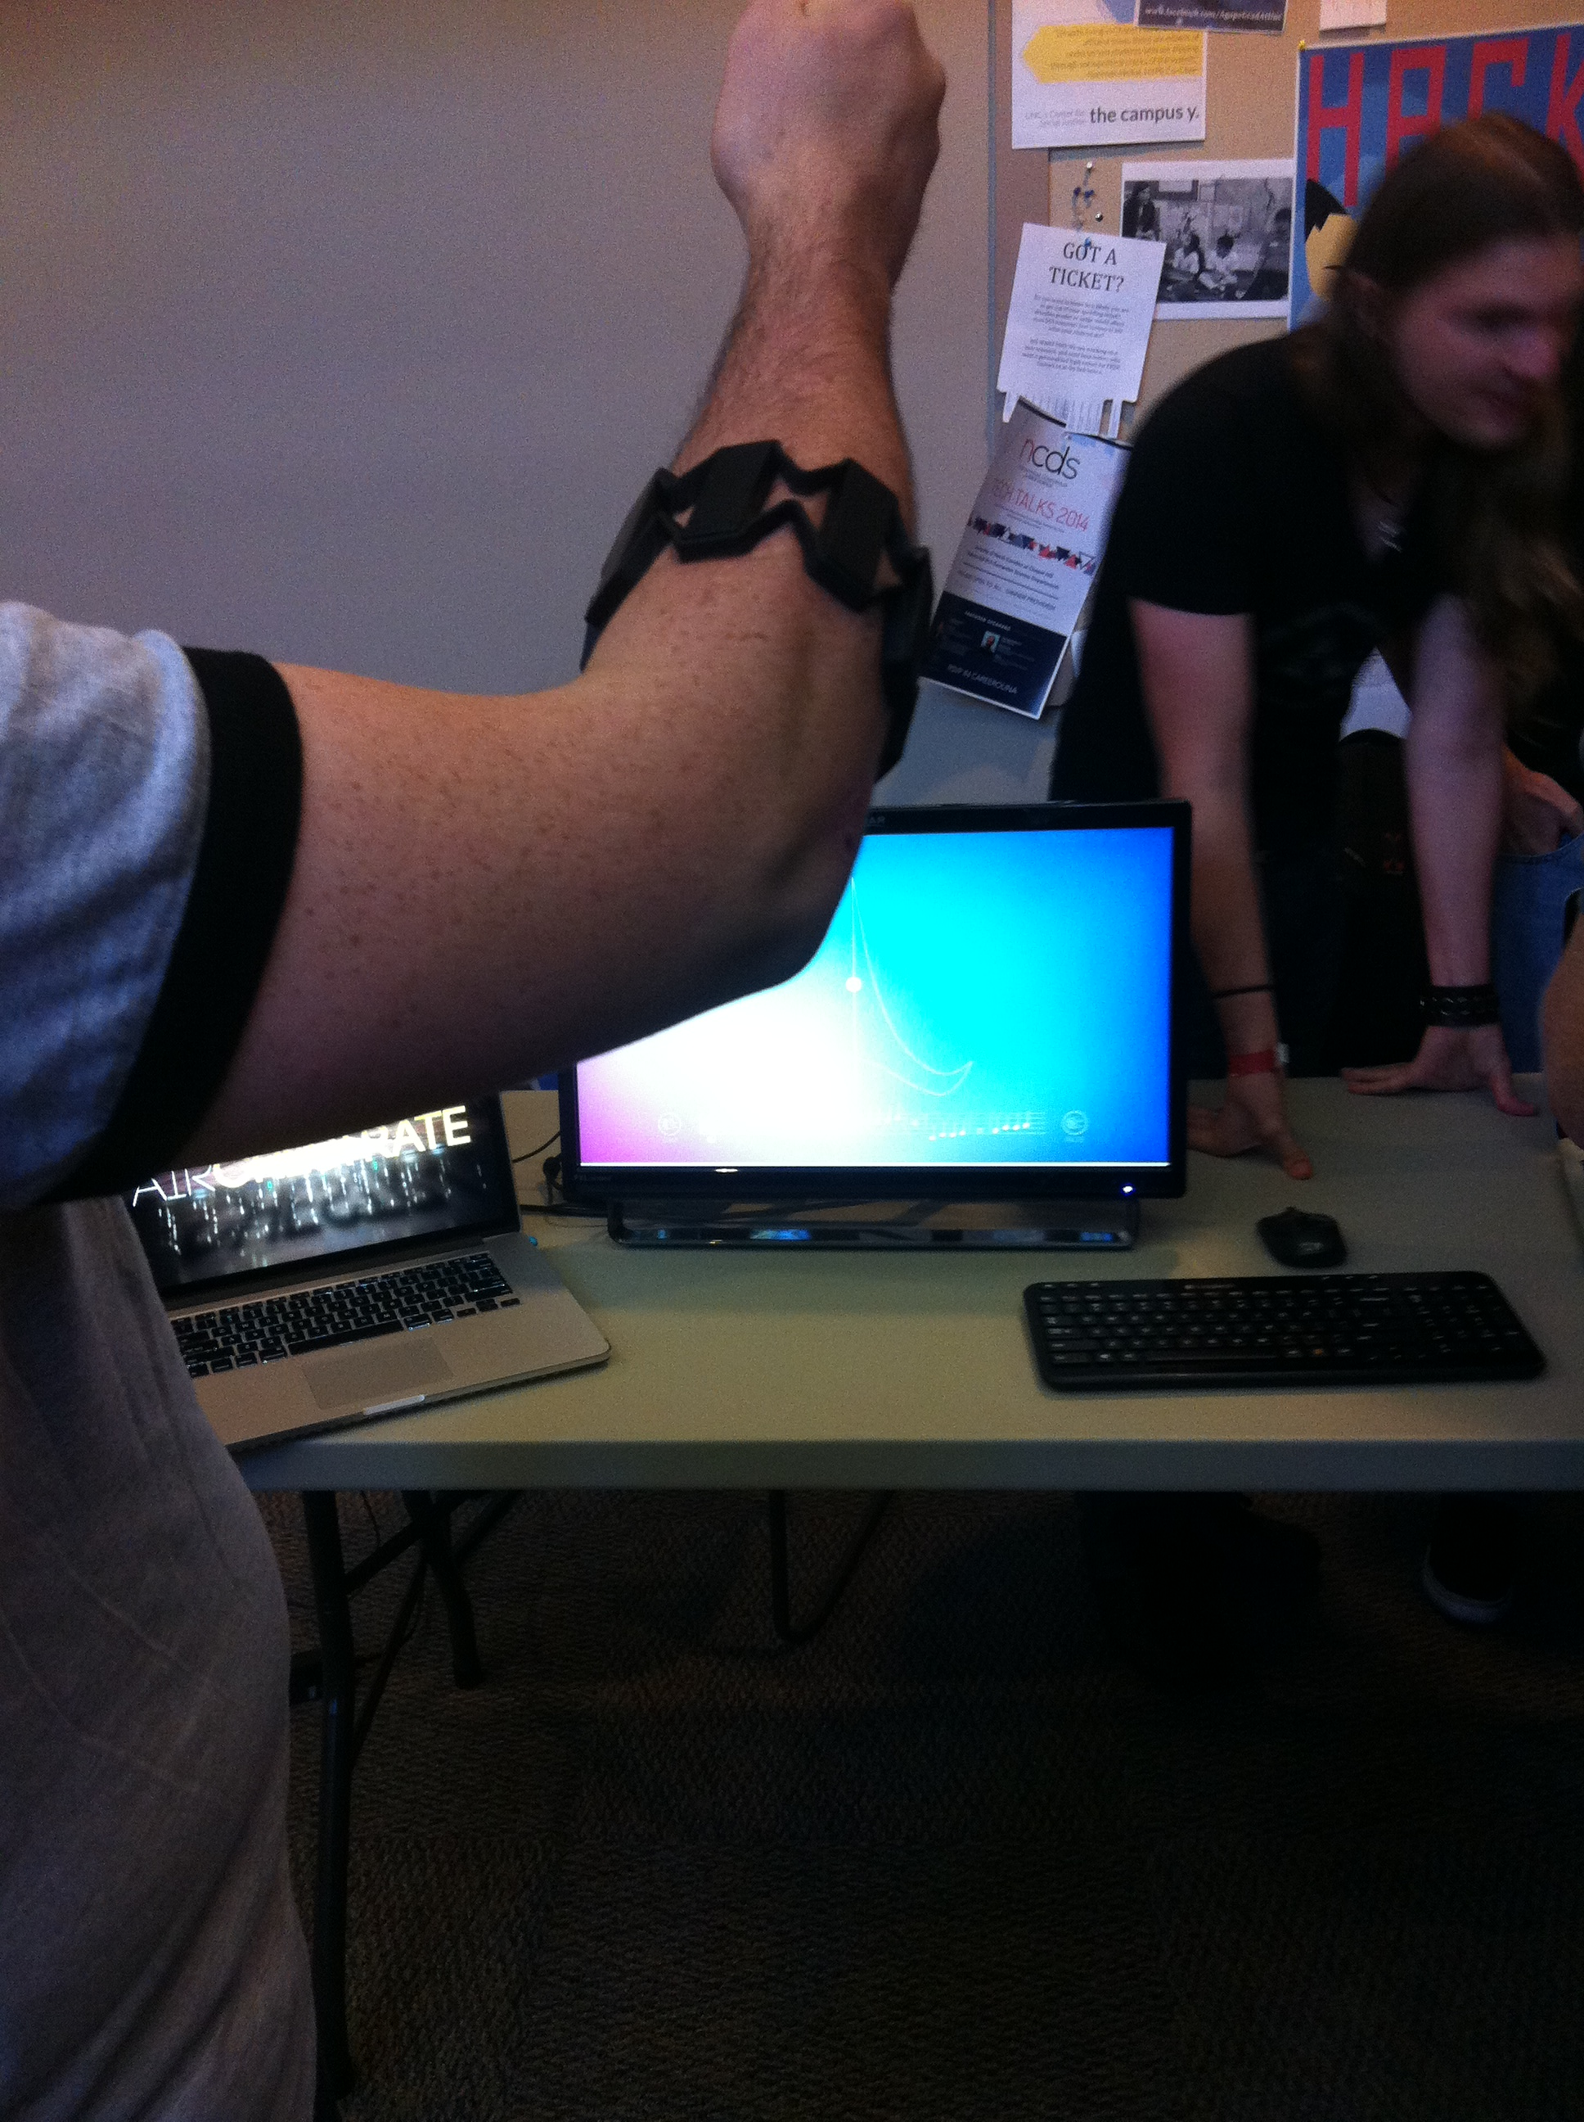
Airchestrate
Michael Richardson, Landon Paik, Eric Yi, Jimin Zheng
Airchestrate uses the Myo gesture control armband to coach both novice conductors as well as professional ones on how to effectively lead a group of musicians. The app uses haptic feedback to teach novices how to properly conduct music to the timing of the specific song. Using the accelerometer in the Myo, the application tracks the intensity of the user's conducting patterns, translating the amplitude of arm movements into louder or softer outputs of music. For experienced conductors, Airchestrate also displays visual representations of the music that they're actively manipulating with their hands. Color gradients in the background actively transform to represent the complex interactions between conductor and music, allowing users to craft vivid stories to audiences through both auditory and visual means.

Slide 9
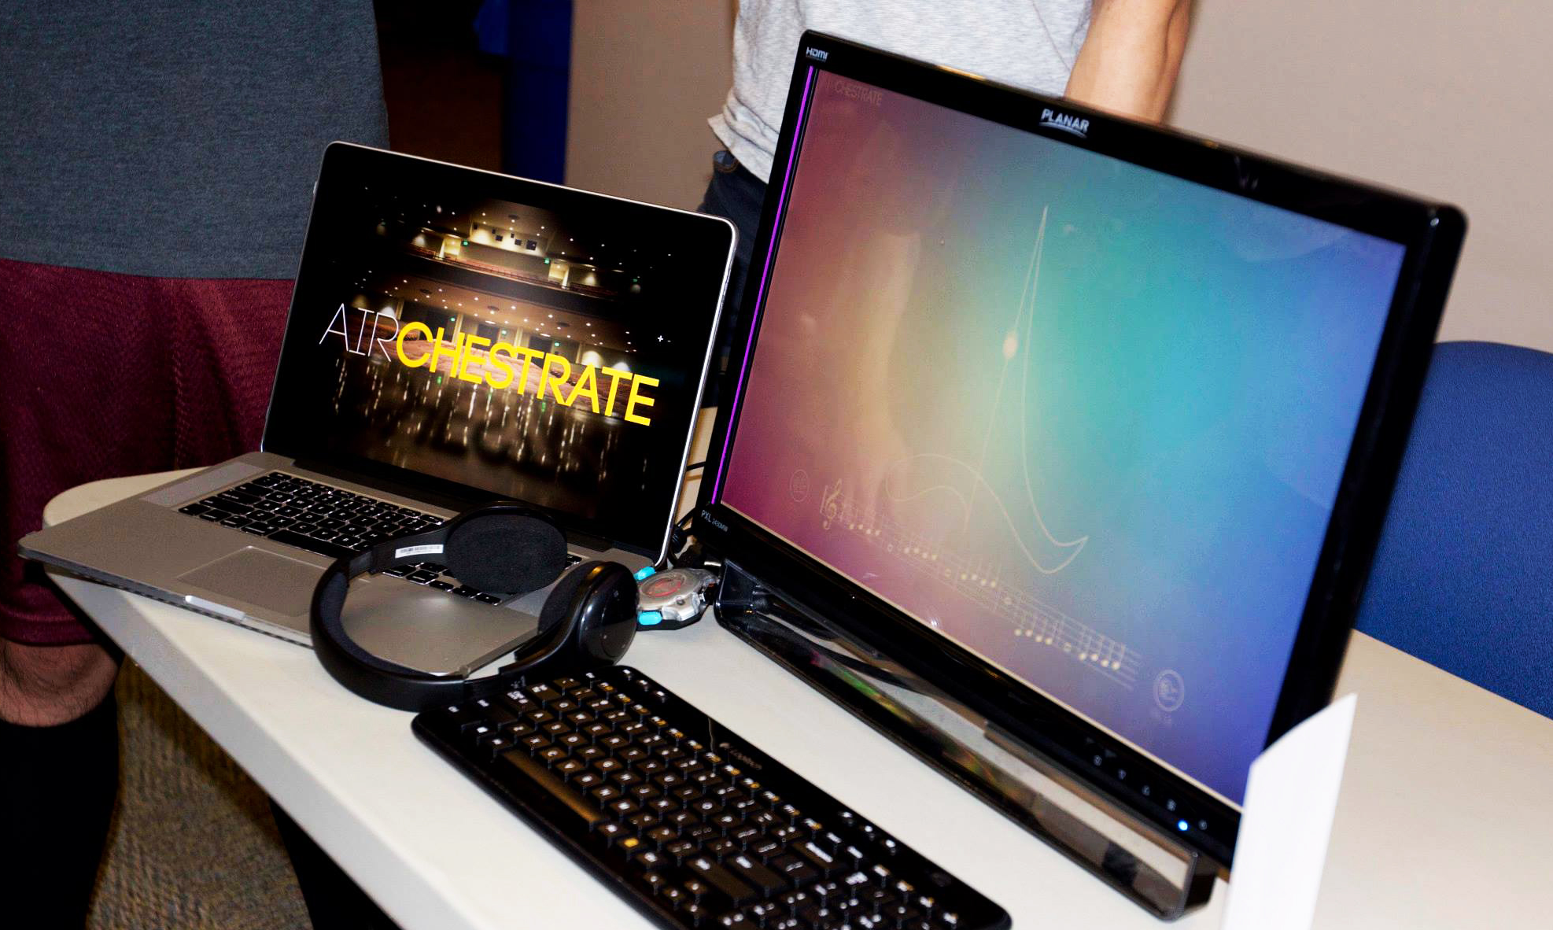
Airchestrate
Michael Richardson, Landon Paik, Eric Yi, Jimin Zheng
Airchestrate uses the Myo gesture control armband to coach both novice conductors as well as professional ones on how to effectively lead a group of musicians. The app uses haptic feedback to teach novices how to properly conduct music to the timing of the specific song. Using the accelerometer in the Myo, the application tracks the intensity of the user's conducting patterns, translating the amplitude of arm movements into louder or softer outputs of music. For experienced conductors, Airchestrate also displays visual representations of the music that they're actively manipulating with their hands. Color gradients in the background actively transform to represent the complex interactions between conductor and music, allowing users to craft vivid stories to audiences through both auditory and visual means.

